Slide 1
Introduction of Math of MBD
Part 2: Solving the MBD Equations of Motion
Graham Sanborn
FunctionBay, Inc. R&D Group.
2022/04/07
Copyright © 2022 FunctionBay, Inc. All rights reserved.

Slide 2
Overview
Goal
Introduce the mathematics of Multibody Dynamics
3 Parts:
MBD Equations of Motion
Solving the Equation of Motion
Special Features
Contact
Flexible bodies

Slide 3
Presentation Parts
MBD requires 2 parts:
Equations of motion
f = ma
The solution to the equations of motion
time stepping
The third part extends MBD’s capabilities.
Flexible bodies and contact

Slide 4
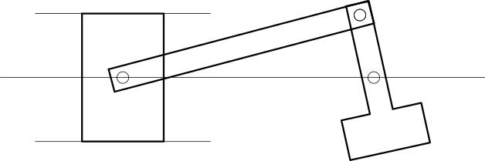
Part 2:
Solving the MBD equations of motion

Slide 5
MBD Equations of Motion
The MBD equations of motion are the acceleration equations.
Solving these equations produces q̈ and λ.
From the values of q and q̇.

Slide 6
Solving the Differential Equation
Getting q, q̇, q̈, and λ from time t = 0 to time t = t_{end} is called “solving the equations of motion”.
Really, this is solving a differential equation (DE).
t
t₀
t₁
t₂
t₃
t₄
t₅
t_{end}

Slide 7
What is a differential equation (DE)?
An equation that defines a relationship between a function and its derivatives.
A 1st order DE might look like this:
y is a function.
It is unknown.
A function of x.
y = a(x)
yʹ is dy/dx.
The DE yʹ = g(x,y) is 1st order
It only contains the first derivative of y.

Slide 8
Forms of DEs
Some DEs cannot be written:
The most general form of a 1st order DE is
Here, yʹ cannot be separated out of g.
This document mostly uses yʹ = g(x,y).
But both versions could be used anywhere in this document.

Slide 9
DEs as Systems of Equations
DEs are often a system of equations.
In this case,
or
y, yʹ, and g are vector quantities.
The methods of solving scalar DEs and vector DEs are mostly identical.

Slide 10
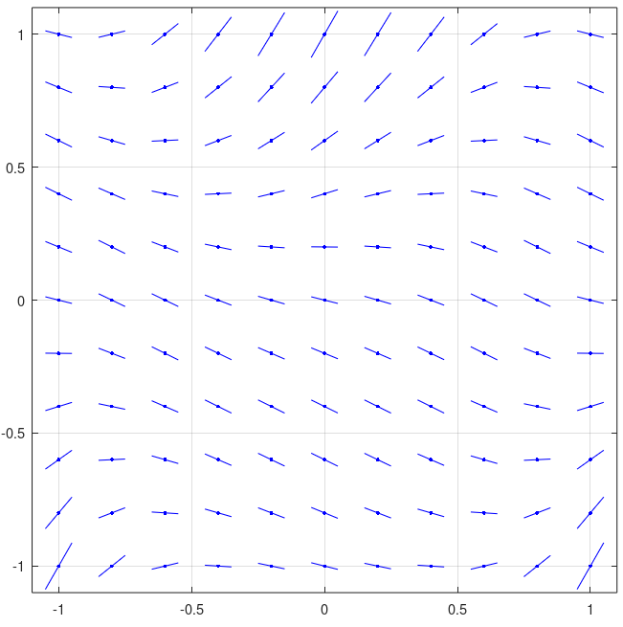
Understanding a 1st order DE
Every point on the x-y plane has a slope.
yʹ at (1,1)
Example 1st order DE:
y
x

Slide 11
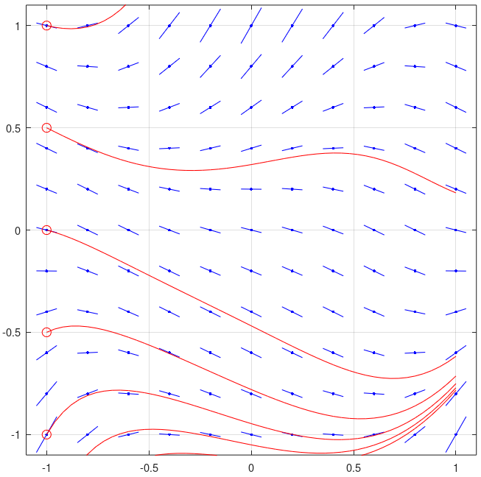
Understanding a 1st order DE
1st order DE example
Solutions:
There are infinitely many solutions.
For a given x₀, every y₀ produces a different solution.
Some example solutions
y
Points with same x₀ = −1
x

Slide 12
Understanding a 1st order DE
1st order DE example solutions:
Solution: y = a(x).
Each y is a function.
It has 1 value at any x.
5 example solutions
Solution containing (-1,-0.5)

Slide 13
2nd order DEs
A 2nd order DE relates a function y and its 1st and 2nd derivatives yʹ and yʺ:
or
where

Slide 14
Newton-Euler Equations as DEs
The Newton-Euler equations are 2nd order DEs:
The independent variable is t and the unknown vector of functions is q.
The solution is

Slide 15
MBD Equations of Motion are Special DEs
Usually, “The MBD equations of motion” means the equations of acceleration. For MBD, these are:
But the equations used to solve the DEs can be different.
This will be shown in much more detail later.
This is φ̈
Not the derivative of φ.

Slide 16
Solving a DE
Usually, “solving the DE” means finding the functions
y = a(x)
yʹ = aʹ(x)
over some interval of x.

Slide 17
No Analytical Solutions
Most DEs have no analytical solution.
No expression for a(x) or aʹ(x) is known to exists.
The DEs for MBD have no analytical solution.

Slide 18
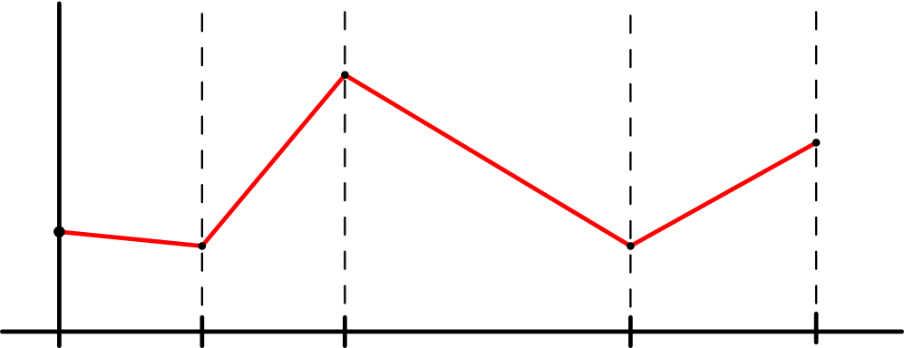
Numerical Methods to Solve DEs
Numerical methods are used to find approximate DE solutions.
“Solving the DE numerically” means finding approximate points in the solution:
(x_{i},y_{i}) and (x_{i},yʹ_{i}) for i = 0 to n_{end}
y
(x₂, y₂)
(x₄, y₄)
(x₀, y₀)
(x₁, y₁)
(x₃, y₃)
x
x₀
x₁
x₂
x₃
x₄

Slide 19
Euler’s Method
Most basic numerical method for solving a DE:
Euler’s method
Approximate y = a(x) as a series of points.
(x_{i},y_{i})
Each point y_{i+1} is calculated from the previous point y_{i} at x_{i} using the slope dy/dx calculated at (x_{i},y_{i}).
y
(x₂, y₂)
(x₄, y₄)
(x₀, y₀)
(x₁, y₁)
(x₃, y₃)
x
x₀
x₁
x₂
x₃
x₄

Slide 20
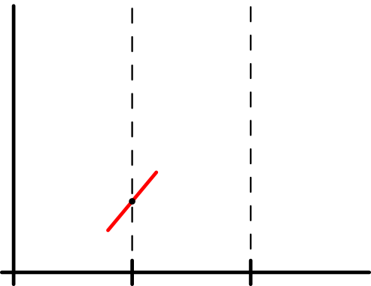
Euler’s Method
Given a known point in the solution:
(x_{i},y_{i})
then dy/dx at (x_{i},y_{i}) can be computed directly from g.
y
x

Slide 21
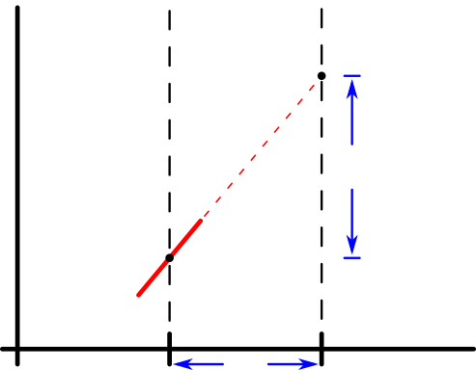
Euler’s Method
Assume that dy/dx is constant between x_{i} and x_{i+1}.
Then step to (x_{i+1}, y_{i+1}) using
y
x

Slide 22
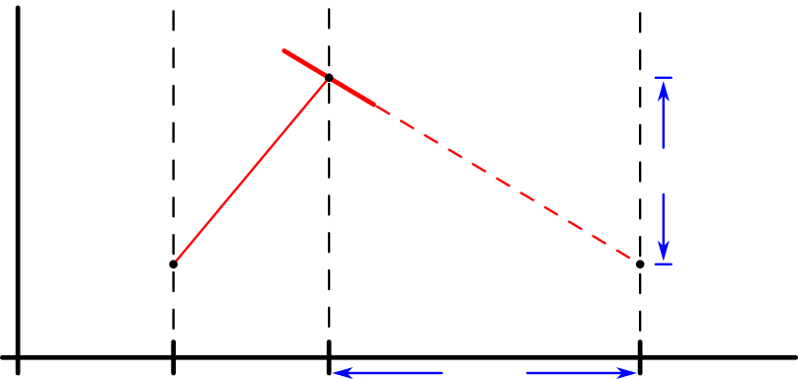
Euler’s Method
Again, approximate the step to the next point using the same algorithm from (x_{i+1}, y_{i+1}) to (x_{i+2}, y_{i+2}).
y
x

Slide 23
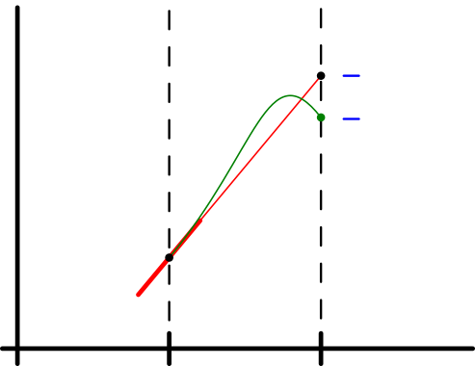
Numerical Solution Error
Error in numerical approximation
There is error in every numerical method for solving DEs.
The error is unavoidable.
However, the error can be reduced though various methods.
Euler’s method will not exactly match the true solution.
The difference between the true solution and Euler’s method is error.
y
True solution
Error
Euler’s method
x

Slide 24
Euler’s Method Error
Source of error in Euler’s method’s
The true solution’s slope is not constant between x_{i} and x_{i+1}.
Euler’s method assumed that it was constant.
y
True solution
Error
(difference between true and approximated solution)
Euler’s method
x

Slide 25
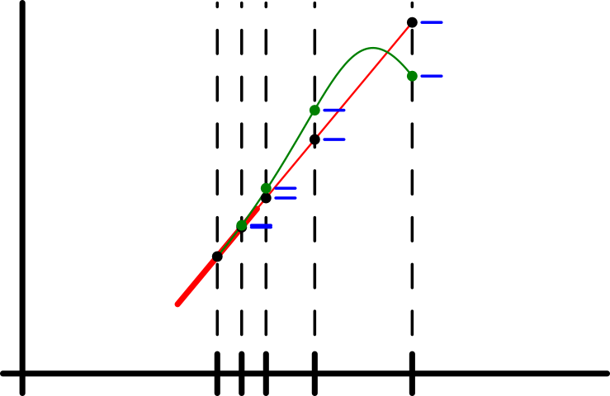
Euler’s Method Error
Euler’s method error reduction:
A smaller step size usually creates less error.
y
Error decreases for smaller step sizes
x
Possible values for

Slide 26
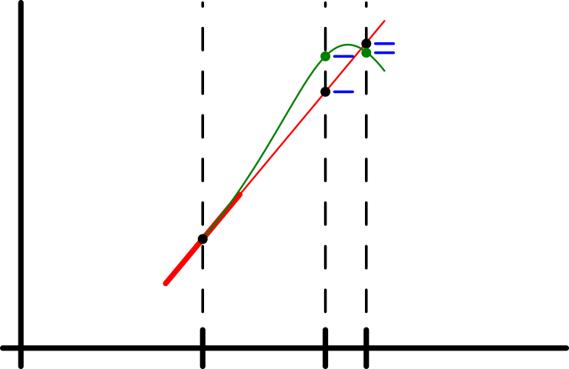
Error Reduction
Be aware:
Smaller steps don’t always create smaller error.
y
Error increases with a slightly smaller step size
x
Possible values for

Slide 27
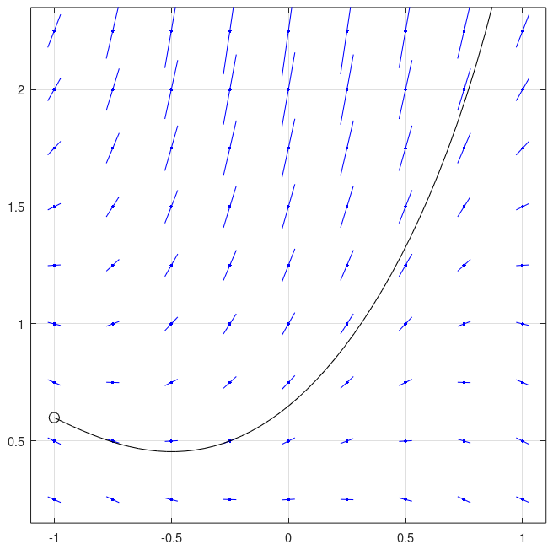
Euler’s Method Example
Euler’s method 1st order error example:
Using the previous 1st order DE example
Solution containing (x,y) = (−1, 0.6)
True solution
y
x

Slide 28
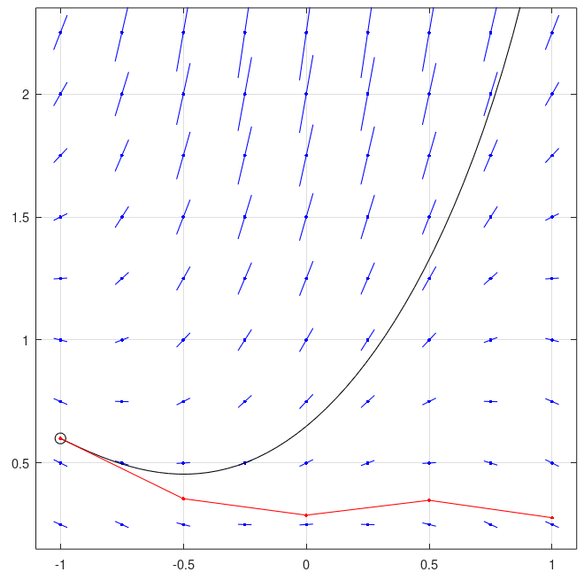
Euler’s Method Example
Euler’s method 1st order error example:
Using Euler’s method to find an approximate solution
h = 1/2
y
x

Slide 29
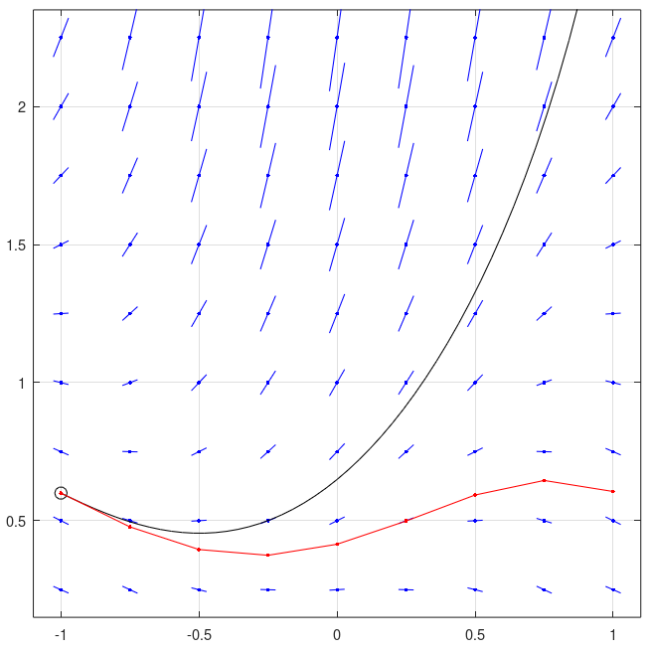
Euler’s Method Example
Euler’s method 1st order error example:
Using Euler’s method to find an approximate solution
h = 1/4
y
x

Slide 30
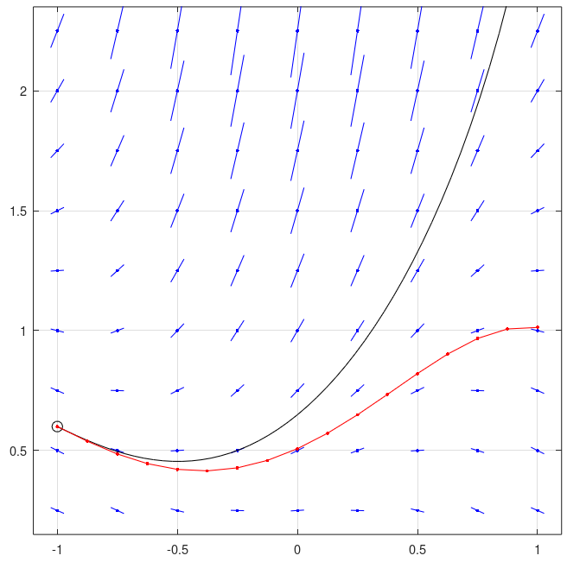
Euler’s Method Example
Euler’s method 1st order error example:
Using Euler’s method to find an approximate solution
h = 1/8
y
x

Slide 31
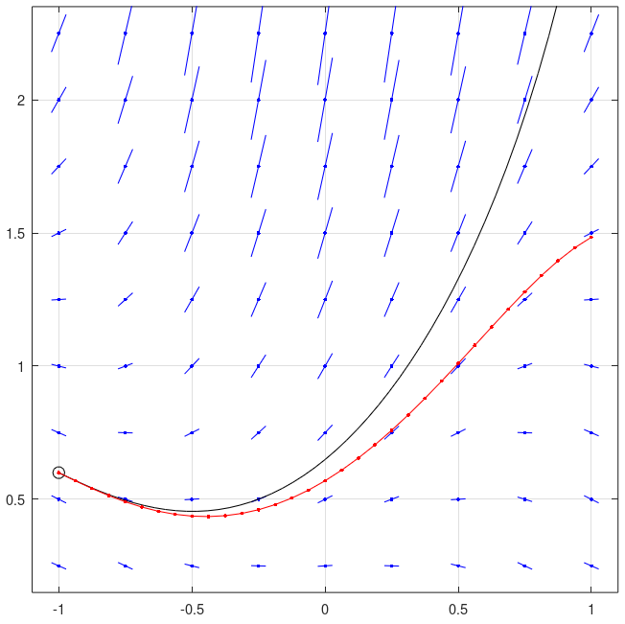
Euler’s Method Example
Euler’s method 1st order error example:
Using Euler’s method to find an approximate solution
h = 1/16
y
x

Slide 32
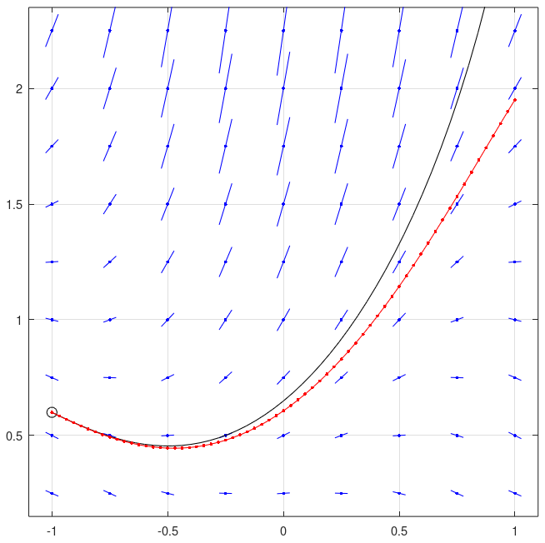
Euler’s Method Example
Euler’s method 1st order error example:
Using Euler’s method to find an approximate solution
h = 1/32
y
x

Slide 33

Euler’s Method Example
Euler’s method 1st order error example:
Using Euler’s method to find an approximate solution
h = 1/64
y
x

Slide 34
Euler’s Method on the Circular DE
Euler’s method on 1st order DE circle example:
A system of DEs.
This DE has a simple analytical solution:

Slide 35
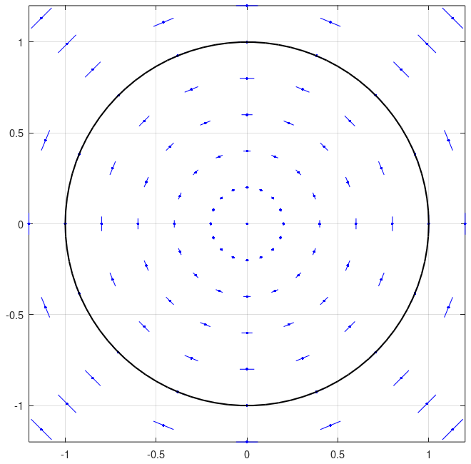
Euler’s Method on the Circular DE
Euler’s method on 1st order DE circle example:
It forms circles of any radius, centered at the origin (0,0).
One true solution and y’
y²
y¹

Slide 36
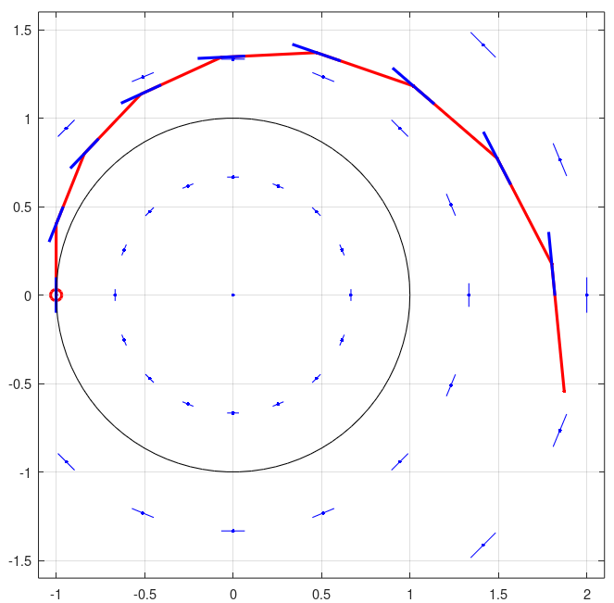
Euler’s Method on the Circular DE
Euler’s method on the circle DE
Each step i is in the direction of yʹ_{i}.
Each step moves away from (0,0).
Euler’s method is unstable.
The Euler solution will go to infinity.
y²
y¹

Slide 37
Euler’s Method Summary for 1st Order DEs
Euler’s method is very simple, very easy to understand.
Maybe the most obvious and simple method.
y moves from y_{i} to y_{i+1} in direction yʹ_{i}.
Euler’s method’s error is significant.
The error grows unstably.
Will eventually go to infinity in many problems.
Reducing step size usually decreases solution error.

Slide 38
Euler’s Method with 2nd Order DEs
MBD and dynamics is not 1st order.
It’s 2nd order.
Euler’s method can be used with 2nd order DEs, too.
With Euler’s method, the usual method is to use Euler’s method on each variable.

Slide 39
Euler’s Method with 2nd Order DEs
Euler’s method can be used with 2nd order DEs, too.
Use Euler’s method twice
For y
The derivative of y is yʹ.
For y’.
The derivative of yʹ is g.
yʹ is one of the solution functions.

Slide 40
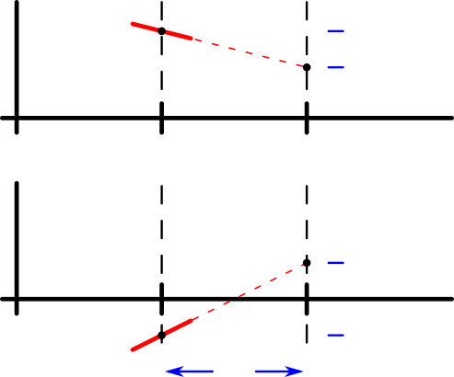
Euler’s Method with 2nd Order DEs
Same as 1st order Euler’s method, but used twice.
Once for y and once for yʹ, every step.
y
Position stepping
The derivative of y is y’, which is already known at xi.
x
yʹ
Velocity stepping
The derivative of y’ is found from g().
x

Slide 41
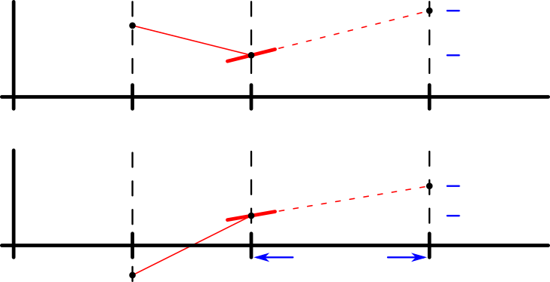
Euler’s method for 2nd order DEs
Similarly to the 1st order Euler’s method, the process is repeated for each additional step.
y
Position stepping
x
yʹ
Velocity stepping
x

Slide 42
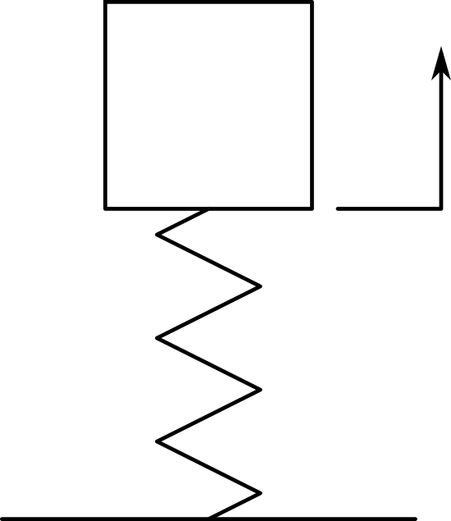
1 DOF Oscillator Example: Euler’s Method
2nd order Euler’s method example:
1 DOF oscillator, no damping
mass m
stiffness k
displacement y
y
m
k

Slide 43
1 DOF Oscillator Equations of Motion
The equation of motion is
A simple 1DOF oscillator preserves energy.
Energy = kinetic energy + elastic strain energy
Should not change over time.
Energy is the easiest to use method of evaluating the accuracy of the DE solution method on this problem.

Slide 44
1 DOF Oscillator True Solution
A well-known closed form solution exists for this model. It can be used to verify the accuracy.
Assuming initial conditions
Known solution is:

Slide 45
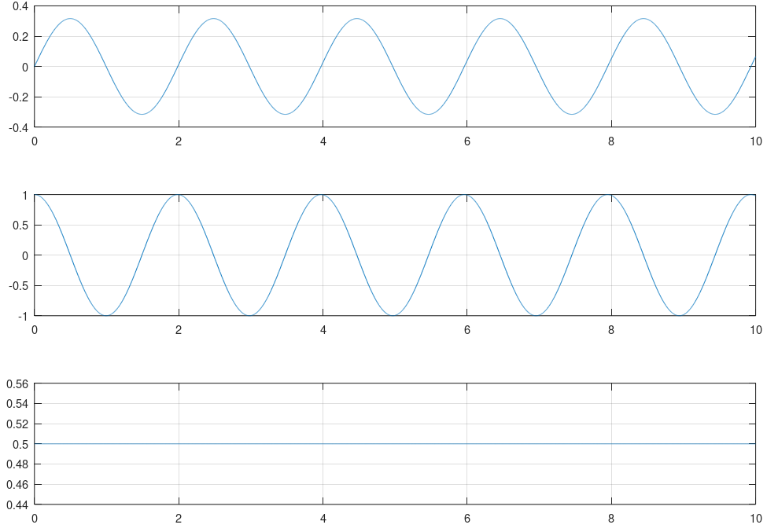
1 DOF Oscillator True Solution
1 DOF oscillator true solution
y₀ = 0
ẏ₀ = 1
k = 10
m = 1
ω = 3.162
a = 0.3162
p = 1.987
U = 0.5
y
ẏ
a = max amplitude
p = period
U = total energy
U
t

Slide 46
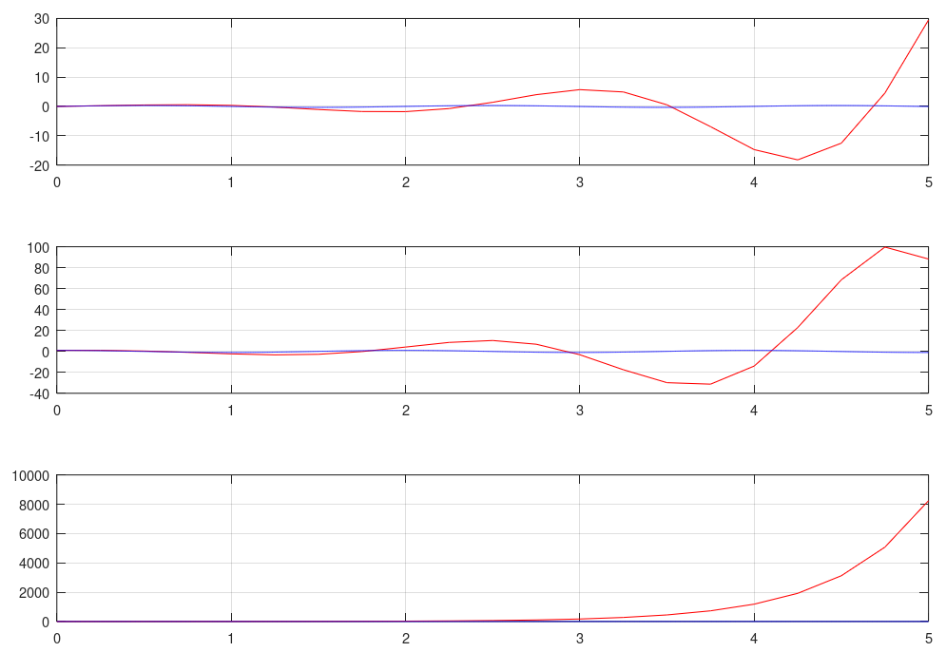
1 DOF Oscillator Example: Euler’s Method
Euler’s method with the 1 DOF oscillator
h = 1/4
y
The time step is too large.
Very unstable.
Error grows very rapidly.
The solution goes to infinity very quickly.
Energy rises extremely fast.
ẏ
U

Slide 47
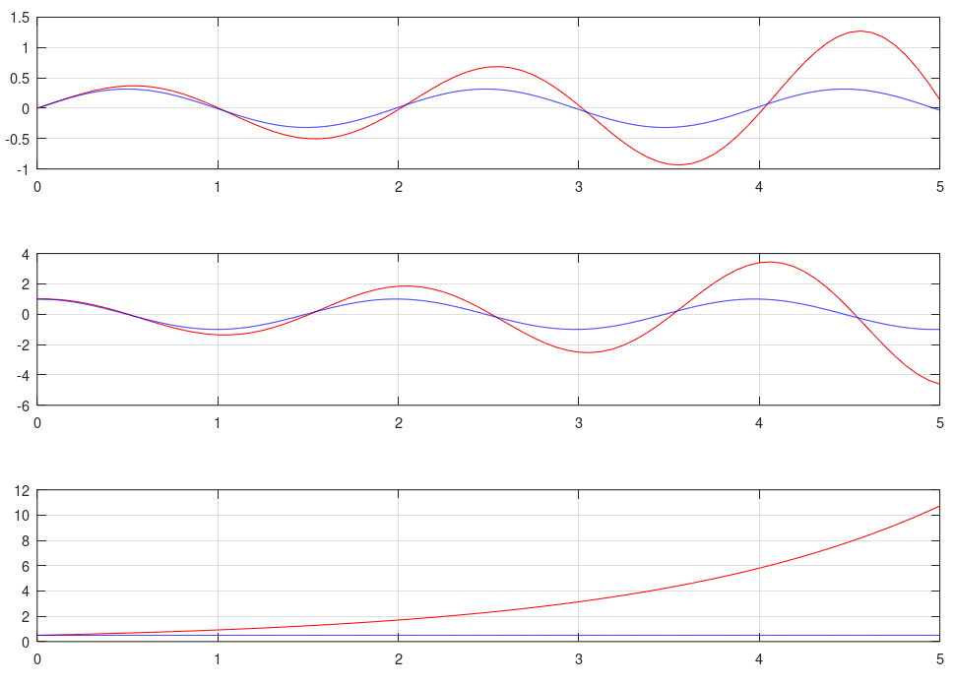
Euler’s method with the 1 DOF oscillator
h = 1/16
y
The time step is too large.
But now the correct trend of the solution can be seen.
ẏ
U

Slide 48
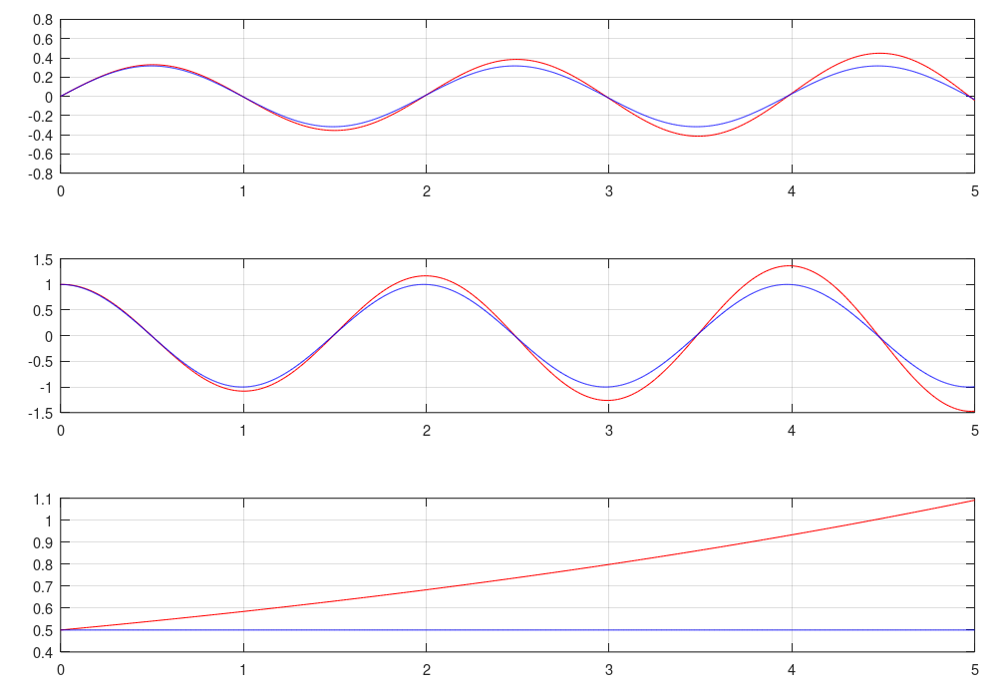
Euler’s method with the 1 DOF oscillator
h = 1/64
y
The time step is large.
But now the correct trend of the solution can be seen.
ẏ
U

Slide 49
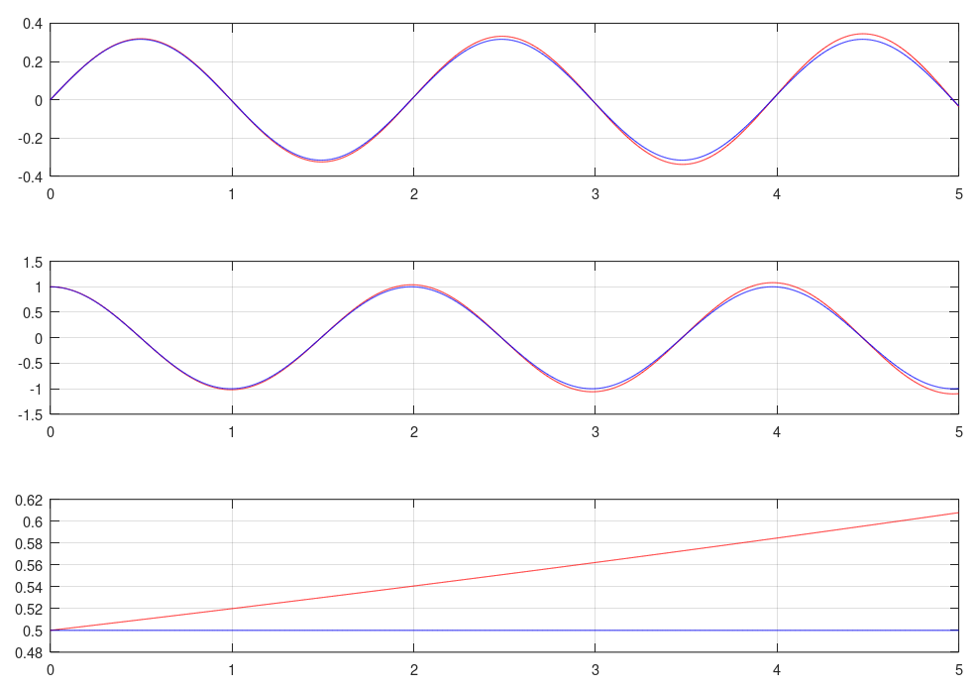
Euler’s method with the 1 DOF oscillator
h = 1/256
y
The solution is almost useful.
Energy only rises a little during the simulation.
ẏ
U

Slide 50
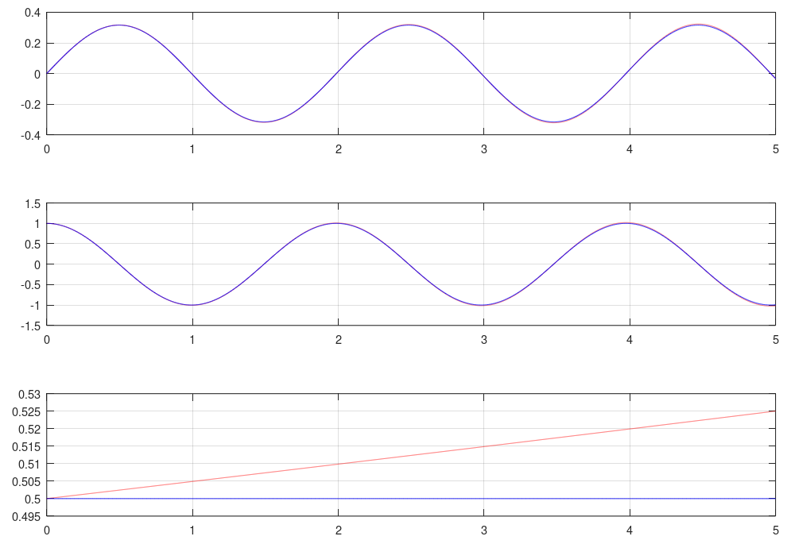
Euler’s method with the 1 DOF oscillator
h = 1/1024
y
Now the solution is mostly acceptable.
If the oscillator had material damping, the solution might be reasonable.
ẏ
U

Slide 51
Euler’s Method Summary
Simplest numerical method to solve DEs.
When used with Newton-Euler equations, energy grows.
Not stable
If the true solution is stable, then the Euler’s method solution will diverge.
If the true solution has damping, then Euler’s method might be reasonable if the time step is small enough.
Accuracy can be increased by reducing time step size.
But the error just grows more slowly.

Slide 52
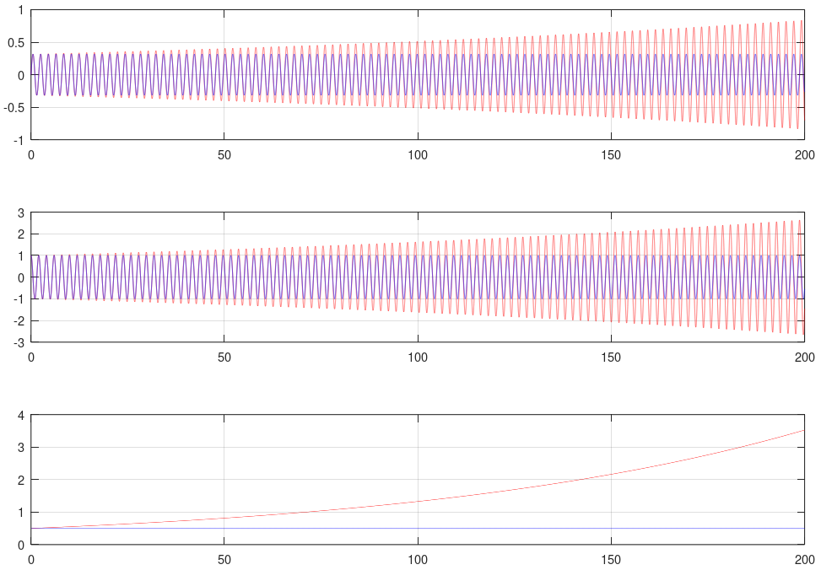
Euler’s Method Summary
Euler’s method with the 1 DOF oscillator
h = 1/1024
for 200 sec.
y
Even with the smallest time step, the solution goes to infinity.
The solution is only reasonable if the simulation is short.
ẏ
U

Slide 53
Symplectic Euler’s Method
There are other, better numerical methods for solving DEs for dynamics.
For example, a small change to Euler’s method for 2nd order DEs:
Creates the “symplectic Euler’s method”.
Also called the “semi-implicit Euler’s method”.
Euler’s method
Symplectic Euler’s method
Initial velocity used to step position
Final velocity used to step position

Slide 54
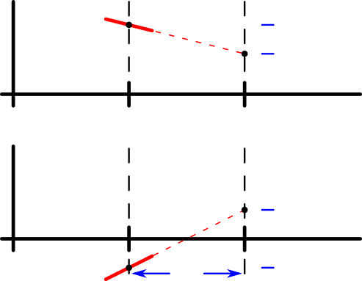
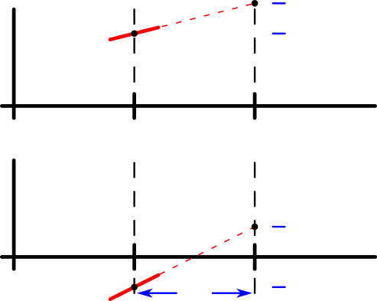
Symplectic Euler’s Method
Comparison of Euler’s method to the symplectic Euler’s Method:
Euler’s method
Symplectic Euler’s method
Position’s slope is velocity at ti
Position’s slope is velocity at ti+1
y
y
x
x
ẏ
ẏ
x
x

Slide 55
Symplectic Euler’s Method
With the symplectic Euler’s method, velocity step is computed before position.
Because updated velocity is needed to compute position step.
Position’s slope is velocity at ti+1
Compute position second.
y
x
Compute velocity first.
ẏ
x

Slide 56
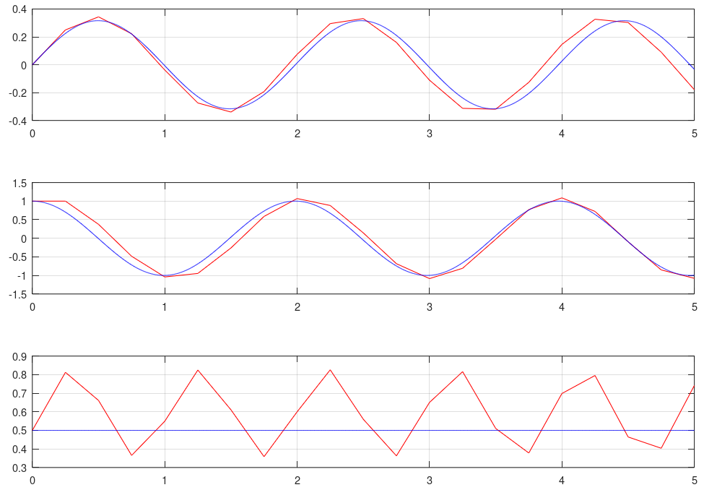
Symplectic Euler’s Method on 1 DOF Oscillator
1 DOF oscillator example using the symplectic Euler method
h = 1/4
y
The energy is not constant, but it oscillates stably around a specific value.
Though the solution accuracy is low, it has mostly the correct shape.
There is a small phase shift from the true solution.
ẏ
U

Slide 57
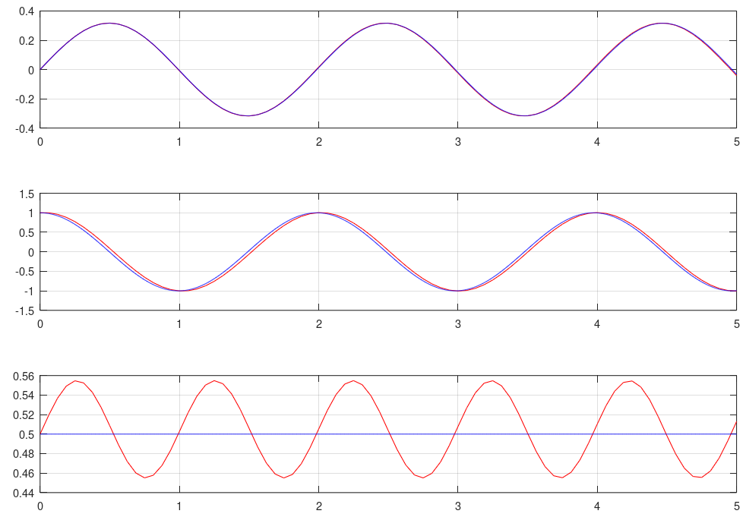
Symplectic Euler’s Method on 1 DOF Oscillator
1 DOF oscillator example using the symplectic Euler method
h = 1/16
y
The solution is now reasonable.
There is a small phase shift in the velocity.
The energy is within 10% of the true energy at all times.
ẏ
U

Slide 58
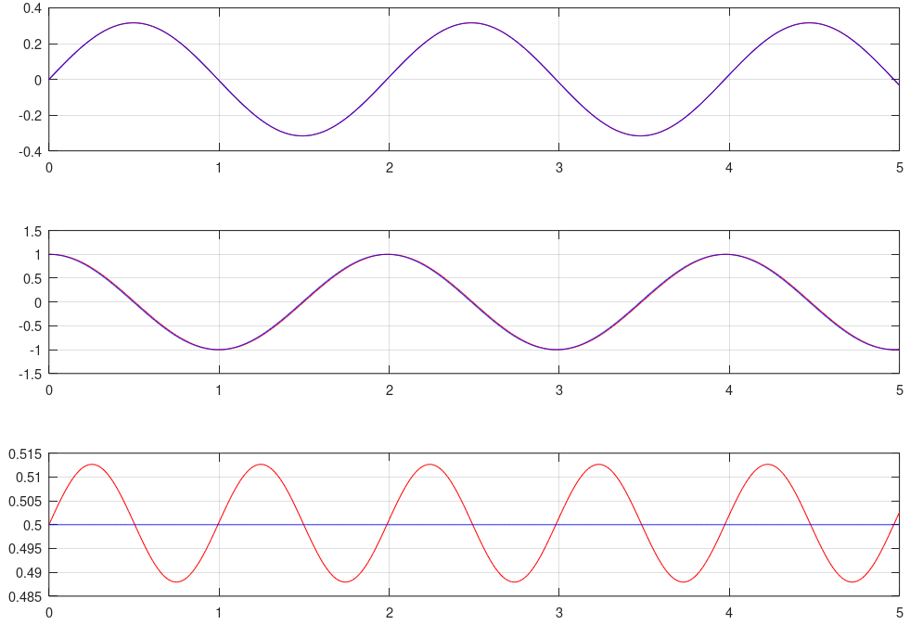
Symplectic Euler’s Method on 1 DOF Oscillator
1 DOF oscillator example using the symplectic Euler method
h = 1/64
y
The solution is good.
ẏ
U

Slide 59
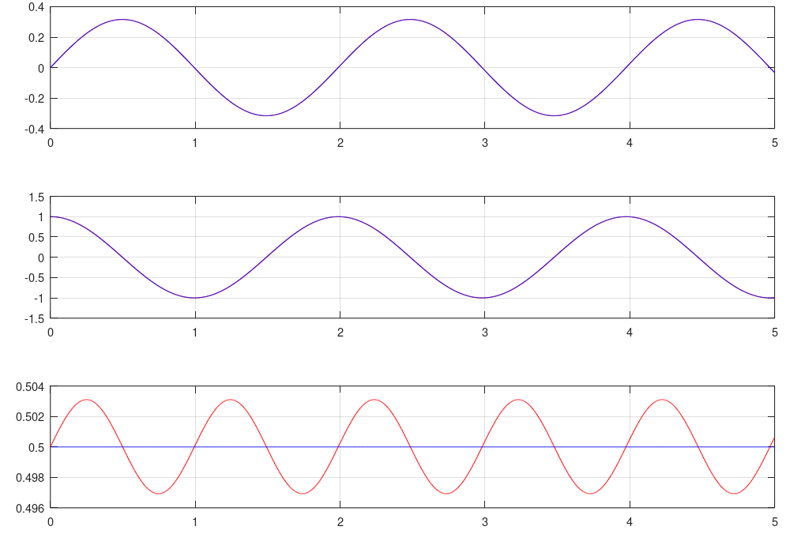
Symplectic Euler’s Method on 1 DOF Oscillator
1 DOF oscillator example using the symplectic Euler method
h = 1/256
y
The solution is now very good.
Energy is within 1% of true energy.
ẏ
U

Slide 60
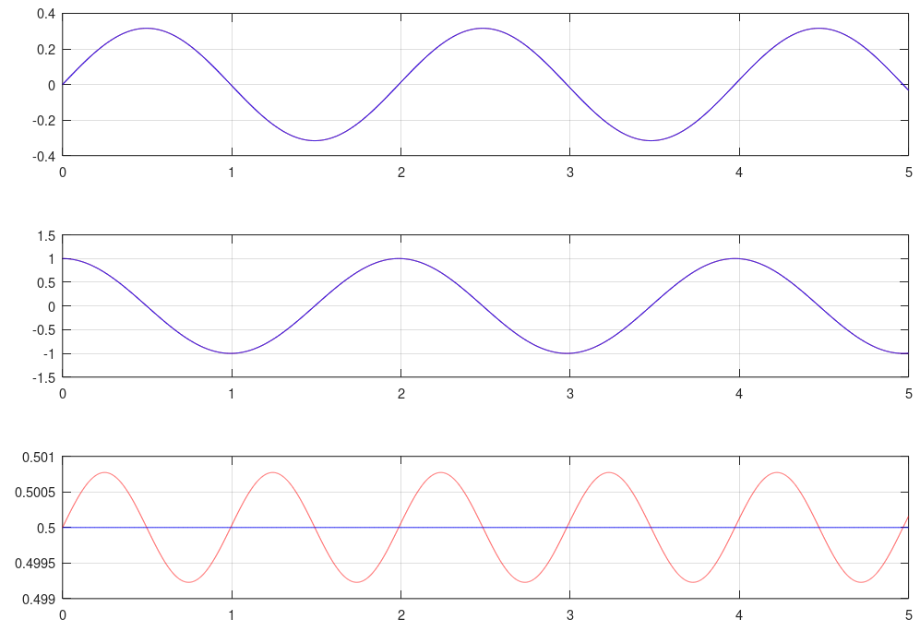
Symplectic Euler’s Method on 1 DOF Oscillator
1 DOF oscillator example using the symplectic Euler method
h = 1/1024
y
The solution is excellent.
The energy is within 0.2% of the true energy.
ẏ
U

Slide 61
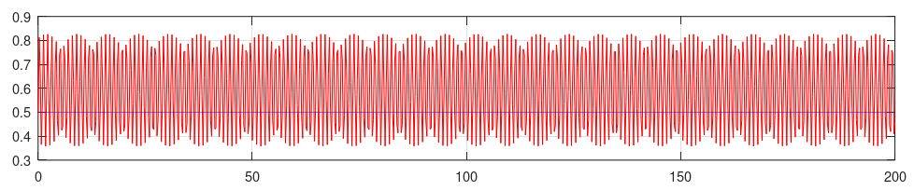
Symplectic Euler’s Method Summary
The symplectic Euler’s method preserves energy with the 1 DOF oscillator.
If h < 2/ω, and if h is constant, then the solution is stable.
The position and velocity don’t go to infinity.
The energy oscillates stably around a fixed value.
Total energy, h = 1/4, for 200sec.
U

Slide 62
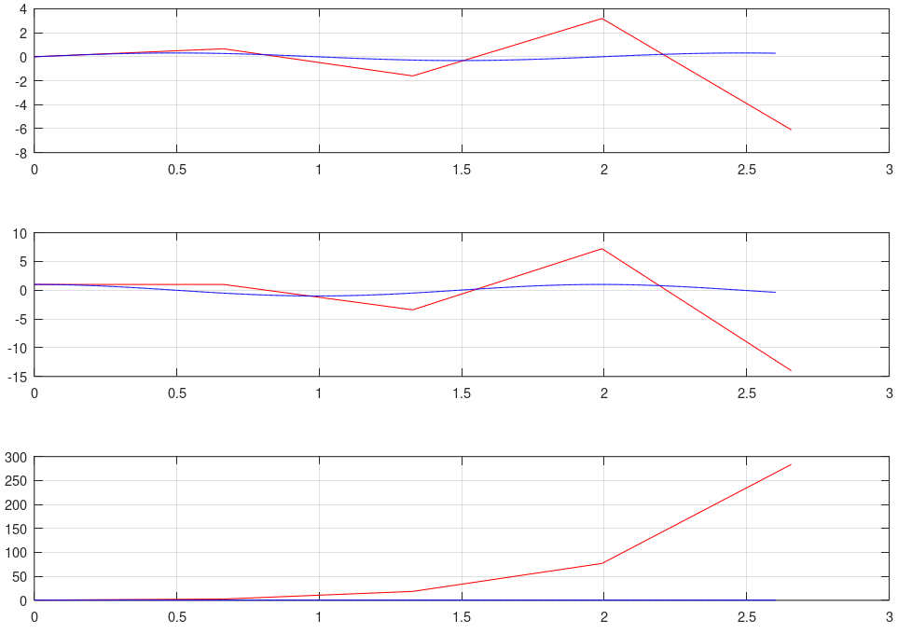
Symplectic Euler’s Method Stability
The symplectic Euler’s method has stability limits.
If the time step is too large (h < 2/ω), then the solution becomes unstable.
y
ẏ
U

Slide 63
Symplectic Euler’s Method Limits
Symplectic Euler are not useful for stiff DEs.
A “stiff” DE has some high frequency oscillations.
It is stiff even if the high frequency DOF is unimportant or the amplitude is extremely small.
The solution is only stable if h < 2/ω_{max.}
ω_{max} is the highest oscillating frequency in the system.
Ideally, h should be much smaller than 2/ω_{max}.
Many MBD systems have very stiff springs.
Bushing elements
Contact stiffness

Slide 64
Implicit Backward Euler’s Method
For MBD, a better numerical DE solution method would be able to take much larger steps stably.
There are numerical methods to solve DEs that are guaranteed to be stable regardless of step size and stiffness.

Slide 65
Implicit Backward Euler’s Method
One such method is the implicit backwards Euler’s method.
For 1st order DEs, the method is
The different from standard Euler’s method is small.
The standard Euler’s method is
This method is called “implicit” because yʹ_{i+1} depends on the unknown value y_{i+1}.
yʹ_{i+1} depends on y_{i+1}
doesn’t depend on y_{i+1}

Slide 66
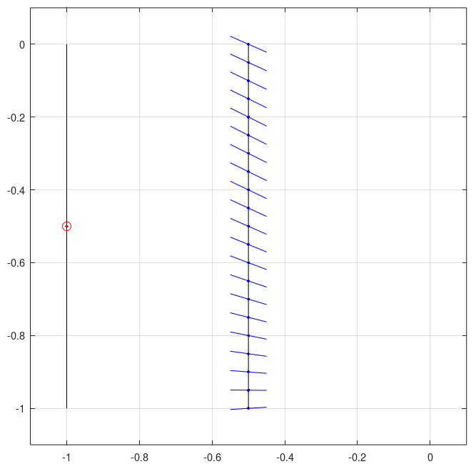
Implicit Backward Euler’s Method
Meaning of the backward implicit Euler’s method:
(Remember, x_{i+1} is a given value.)
Find a point at this x whose slope passes through the initial point
(x_{i}, y_{i})
x_{i}
x_{i+1}

Slide 67
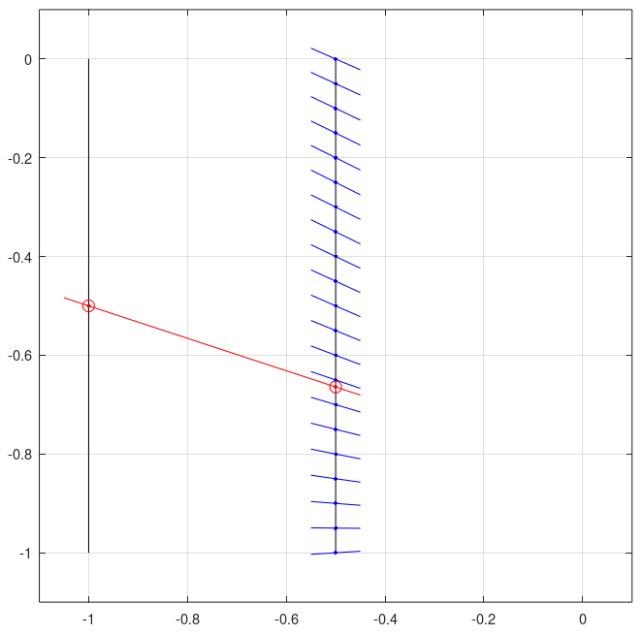
Implicit Backward Euler’s Method
Meaning of the backward implicit Euler’s method:
(Remember, x_{i+1} is a given value.)
The slope from this point must pass through the initial (x_{i}, y_{i}) point.
We must find y_{i+1} that satisfies this property.
(x_{i}, y_{i})
(x_{i+1}, y_{i+1})
yʹ_{i+1}
x_{i}
x_{i+1}

Slide 68
Solving an Implicit Backward Euler Step
Solving the backward implicit Euler method requires solving these equations:
If g(x_{i+1}, y_{i+1}) is nonlinear, then a nonlinear equation solver is needed.
For example, Newton’s method.

Slide 69
Solving an Implicit Backward Euler Step
Solving the backward implicit Euler method using Newton’s method:
Use the first equation to write yʹ_{i+1} as a function of y_{i+1}.
Then convert the second equation into the Newton residual r:

Slide 70
Solving an Implicit Backward Euler Step
Solving the backward implicit Euler method using Newton’s method:
Then find y_{i+1} such that r(y_{i+1}) = 0.
First, set y_{i+1} to an initial guess.
For example, y_{i+1}⁰ = y_{i}
where the superscript ⁰ indicates the iteration count.

Slide 71
Solving an Implicit Backward Euler Step
Solving the backward implicit Euler method using Newton’s method:
Iterate using
until |r ^{j}| < ε
(ε is a user-defined small tolerance)

Slide 72
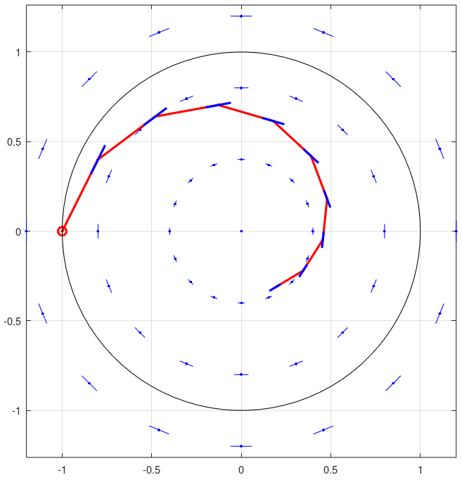
Circle DE with the Implicit Backward Euler’s Method
Solving the circle DE using the implicit backward Euler method
Every step moves closer to the origin.
The error in each step adds stability to the solution.
The accuracy is similar to the explicit Euler method.
The solution is very stable.
It does not go to infinity.

Slide 73
Implicit Backward Euler with 2nd Order DEs
Identically with the standard Euler’s method, the implicit backward Euler’s method can solve 2nd order DEs.
For 2nd order DEs, the method is applied twice
Once for position
Once for velocity.

Slide 74
Implicit Backward Euler with 2nd Order DEs
Solving a time step of 2nd order DE backward Euler
The method is described by 3 equations:
The first 2 equations are used to write ẏ_{i+1} and ÿ_{i+1} as functions of y_{i+1}.

Slide 75
Implicit Backward Euler with 2nd Order DEs
Solving a time step of 2nd order DE backward Euler
The equation that defines ÿ_{i+1} is converted into a Newton residual:
To solve r(y_{i+1}) = 0, use Newton’s method.
This requires the derivative:
where

Slide 76
Implicit Backward Euler with 2nd Order DEs
Solving a time step of 2nd order DE backward Euler
Solve r(y_{i+1}) = 0 iteratively
until |r ^{j}| < ε

Slide 77
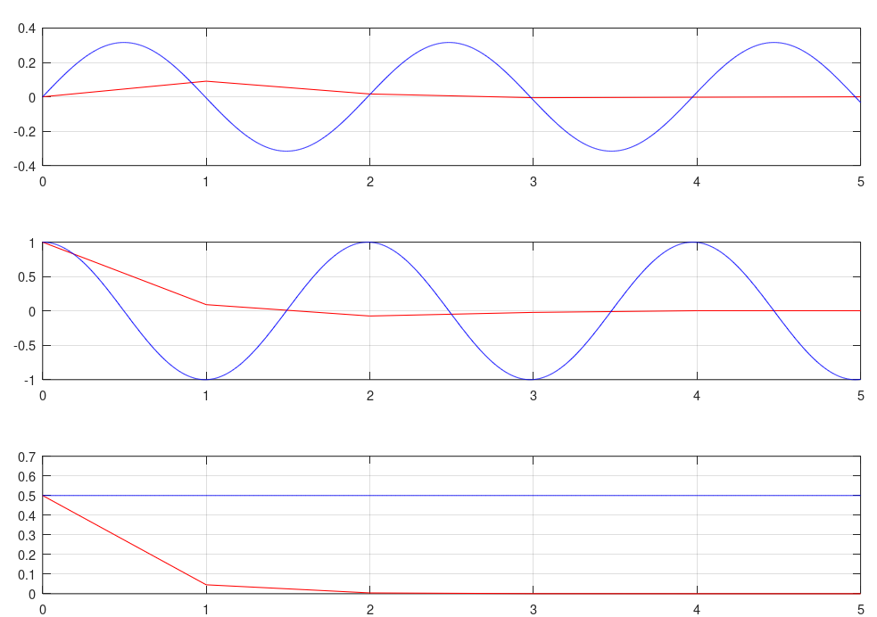
Implicit Backward Euler with the 1 DOF Oscillator
Solving the 1 DOF oscillator 2nd order DE using the implicit backward Euler method
h = 1
y
The time step is very large, but the solution is completely stable.
Accuracy is very low.
The energy disappears extremely quickly.
ẏ
U

Slide 78
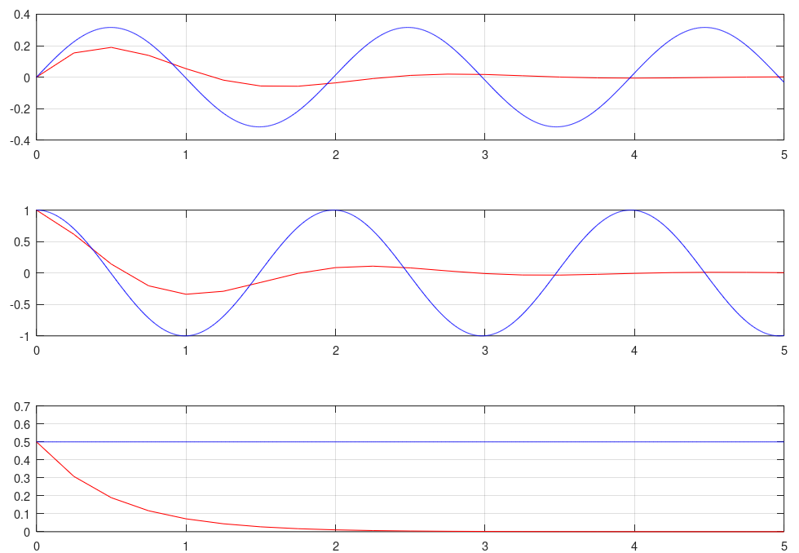
Implicit Backward Euler with the 1 DOF Oscillator
Solving the 1 DOF oscillator 2nd order DE using the implicit backward Euler method
h = 1/4
y
The accuracy is still very poor.
The energy is still disappears very quickly.
ẏ
U

Slide 79
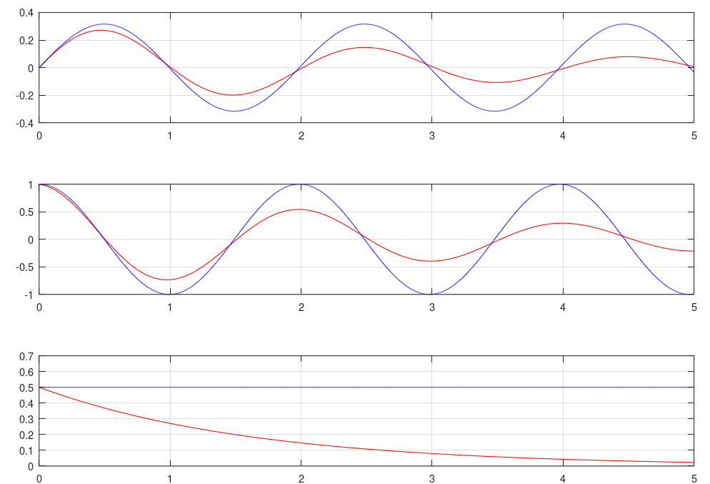
Implicit Backward Euler with the 1 DOF Oscillator
Solving the 1 DOF oscillator 2nd order DE using the implicit backward Euler method
h = 1/16
y
The solution is beginning to follow the curve.
ẏ
U

Slide 80
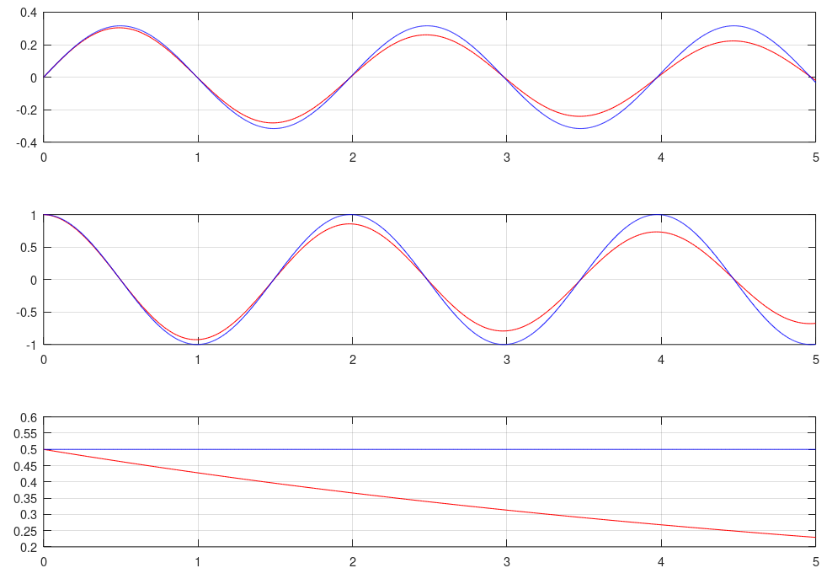
Implicit Backward Euler with the 1 DOF Oscillator
Solving the 1 DOF oscillator 2nd order DE using the implicit backward Euler method
h = 1/64
y
The solution follows the curve enough to see the gross behavior.
The energy drops quickly.
ẏ
U

Slide 81
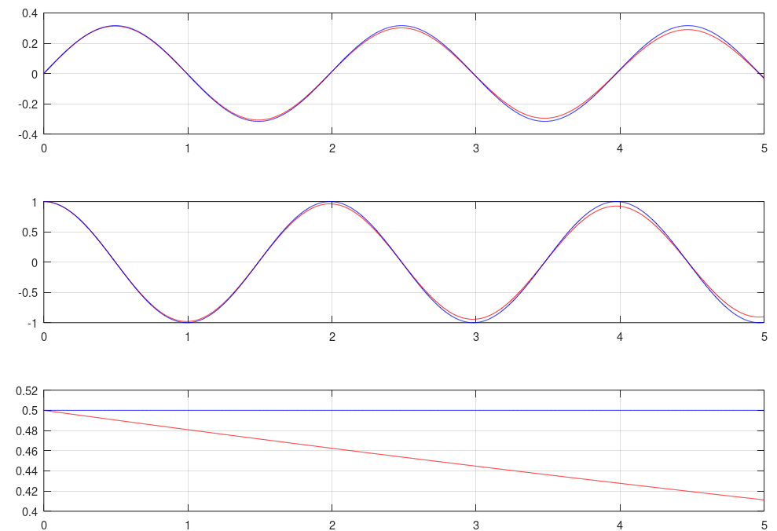
Implicit Backward Euler with the 1 DOF Oscillator
Solving the 1 DOF oscillator 2nd order DE using the implicit backward Euler method
h = 1/256
y
The solution is becoming good.
The energy drops slowly.
ẏ
U

Slide 82
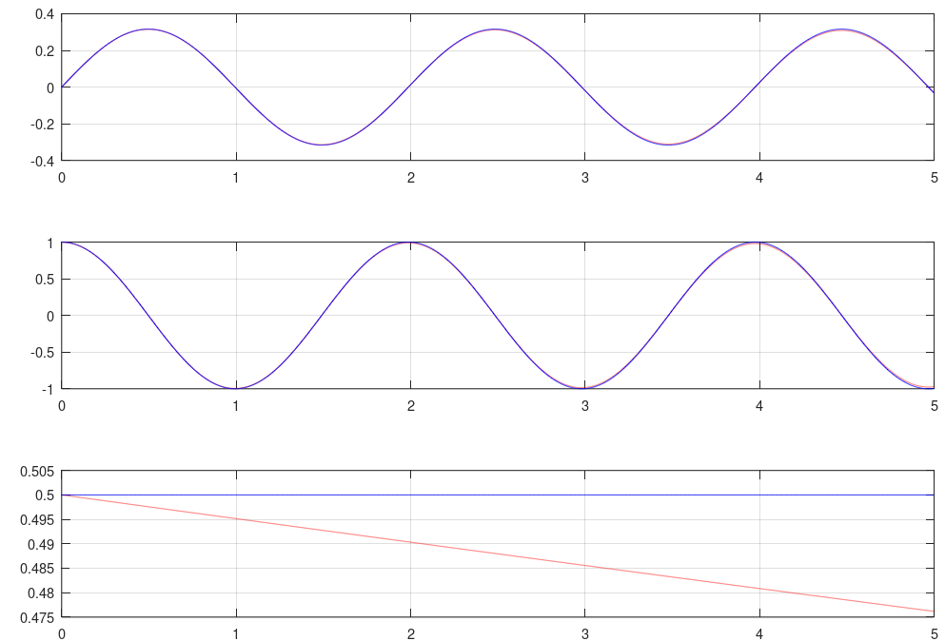
Implicit Backward Euler with the 1 DOF Oscillator
Solving the 1 DOF oscillator 2nd order DE using the implicit backward Euler method
h = 1/1024
y
The solution is excellent.
The energy loss is slow.
ẏ
U

Slide 83
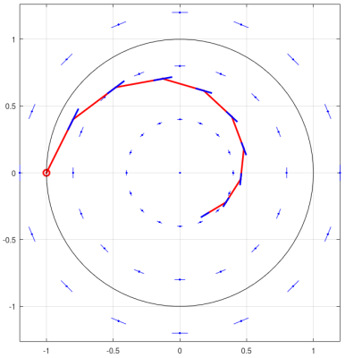
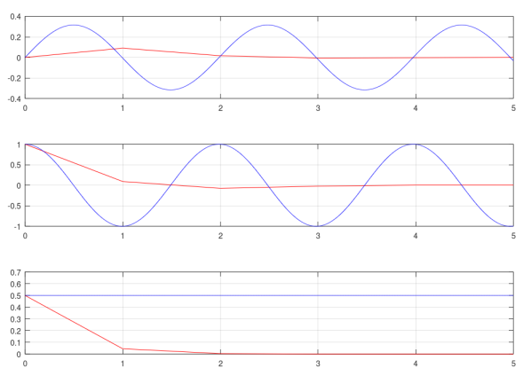
Implicit Backward Euler’s Method Summary
The loss of energy caused by the numerical method is called “numerical damping”.
DE solution methods that have numerical damping are usually very stable.
The step size can be chosen for accuracy rather than for stability.
Accuracy is low but stability is high if the time steps are too large.
The implicit backward Euler method
has very high numerical damping.

Slide 84
There are numerical methods that have user-adjustable numerical damping.
Implicit methods with adjustable numerical damping are very useful for MBD.
They allow for the user to tune the amount of damping, but are very stable.

Slide 85
The Newmark Method
The Newmark method is a common, simple method with tunable numerical damping.
RecurDyn’s DE solver is very similar to the Newmark method.
RecurDyn uses the Generalized-α method.
The Newmark method is a 2nd order DE solver.
Originally designed for solving dynamics problems in linear finite elements.

Slide 86
The Newmark Method
Newmark method details
There are 2 tunable parameters: β and γ
Usually, the ranges of are specified as
0 ≤ β ≤ 1/2
0 ≤ γ ≤ 1
A quadratic equation
Use the form of g() that contains ÿ.

Slide 87
The Newmark Method
The Newmark method is usually used as an implicit method.
If β ≠ 0 or γ ≠ 0, then the method is implicit.
Usually, we use the range
1/4 ≤ β ≤ 1/2
1/2 ≤ γ ≤ 1

Slide 88
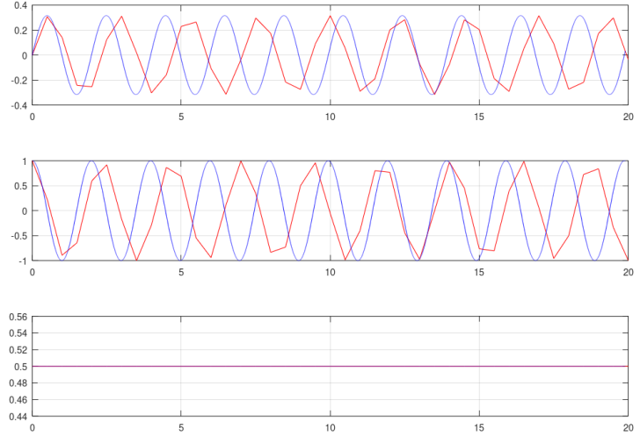
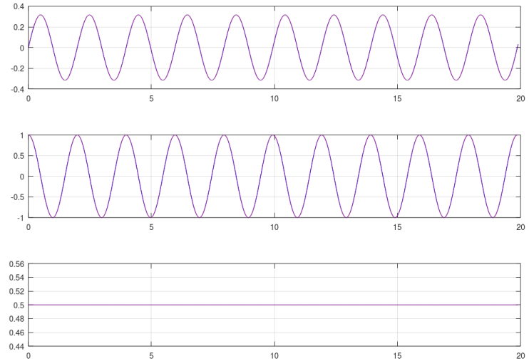
The Newmark Method with the 1 DOF Oscillator
The Newmark method with β = 1/4 and γ = 1/2,
Becomes the implicit trapezoidal method.
This has neutral stability.
There is no numerical damping.
The 1 DOF oscillator preserves energy perfectly, regardless of time step size.
h = 0.5
h = 0.01

Slide 89


The Newmark Method with the 1 DOF Oscillator
The Newmark method with β = 1/2 and γ = 1,
Becomes similar to the implicit backwards Euler method.
Energy is lost quickly.
But unconditionally stable.
Time step size can be chosen for accuracy without considering stability.
h = 0.5
h = 0.01

Slide 90
Solving an Implicit Newmark Time Step
Implementing the Newmark method
There is only 1 independent function. We choose it to be y_{i+1}.
Use the first 2 equations to make ẏ_{i+1} and ÿ_{i+1} be functions of y_{i+1}.
where

Slide 91
Solving an Implicit Newmark Time Step
Implementing the Newmark method
Then use the last equation as the Newton residual
and solve r(y_{i+1}) = 0 using Newton’s method.

Slide 92
Solving an Implicit Newmark Time Step
Implementing the Newmark method
The Jacobian of r(y_{i+1}) is
Where and are used to find:
and

Slide 93
Solving MBD DEs
Solving the MBD equations of motion
The MBD equations of motion
Are DEs.
But not simple DEs.
They are “differential algebraic equations” (DAEs).
They can be solved with the previously shown methods.
But there are some extra details required.

Slide 94
MBD DAEs
Differential Algebraic Equations (DAEs)
The algebraic equations are usually either
or
Differential equations
Algebraic equations

Slide 95
DAEs Require Modifications to Solve
Solving the MBD DAEs with the previous solvers requires modifications to either the equations of motion or to the numerical method.
A problem occurs if no modifications are made.
With no modification, the solution method would be:
Use
to get q̈ . The values of λ can be ignored.
Then use q̈ in one of the DE solution methods previously shown.

Slide 96


Constraint Drift if No Modifications Used
If the DE solution method was exact, then the method on the previous slide would be adequate.
But all DE solutions have error.
The error in q would cause the constraints to be violated.
Constraints violated: φ ≠ 0
The bodies drift apart.
Bodies drift apart (t > 0)
Initial config (t = 0)
φ ≠ 0
φ = 0
Notes:
=

Slide 97
Strategies to Prevent Constraint Violation
MBD theory requires that φ = 0 always.
So a strategy is required to enforce this.
2 common strategies:
Modify the DAE equations of motion and use an implicit DE solver (for example, Newmark or Generalized-α)
RecurDyn uses this method.
This is the most common method.
Coordinate partitioning

Slide 98
Modifying the DAEs for Implicit DE Solvers
The equations of motion can be modified to allow implicit solvers to enforce φ = 0 directly.
This means modifying g(t, q, q̇, q̈) = 0.
Note that for MBD, g is a DAE.

Slide 99
Modifying the DAEs for an Implicit Solver
The acceleration version of g, which would be used for unmodified DE solvers, is:
For implicit DE solvers, the constraint equations are used directly in g.
φ

Slide 100
The Newmark Method for DAEs of MBD
The resulting set of equations to solve the MBD DAEs with the Newmark method are
These equations directly find λ_{i+1} values enforce φ = 0 at t_{i+1}.

Slide 101
Solving the Newmark Time Step
Solving a single MBD time step using the Newmark method with the modified DAEs
Identical to the DE Newmark method.
where

Slide 102
Solving the Newmark Time Step
Solving a single MBD time step using the modified Newmark method
r uses the modified g
where g is

Slide 103
Solving the Newmark Time Step
This is solved with a Newton-Raphson loop.
“Raphson” means that this is Newton’s method used to solve a system of equations.
Find r(q_{i+1}) = 0 iteratively using
where the chain rule of differentiation produces
and

Slide 104
Numerical Damping for Implicit DAE Solutions
Numerical damping is required for implicit solutions to DAEs.
If numerical damping is not used, the solution is unstable.
The amount of numerical damping required depends on the problem.

Slide 105
RecurDyn Simulation Execution
RecurDyn executes a simulation in a specific manner.
Fundamentally, that process has 2 main parts:
Initialization
Stepping
Initialize model & solver
Step t from t₀ to t_{end}

Slide 106
RecurDyn Simulation Execution
Initialize model and solver:
Read Model Input
Eliminate redundant φ
Find q₀, q̇₀, q̈₀
q_{i} = q₀
q̇_{i} = q̇₀
q̈_{i} =t q̈₀
t = 0

Slide 107
RecurDyn Simulation Execution
Step t from t₀ to t_{end}
Each step is solved with Newton’s method.
q_{i+1} = q_{i}, q̇_{i+1} = q̇_{i}, q̈_{i+1} = q̈_{i}, t_{i+1} = t_{i} + h
if accuracy high, increase h
Get r^{j}
Reduce h
accuracy low?
if t_{i} is output time, generate output
Get r_{,q}^{j}
Yes
q_{i+1}^{j+1} = q_{i+1}^{j} - r^{j}*(r_{,q}^{j})⁻¹
No
No
|r^{j}| <= tol?
Yes
t_{i} >= t_{end}?
Update q̇_{i+1}, q̈_{i+1},
No
Yes
Done
q_{i} = q_{i+1}, q̇_{i} = q̇_{i+1}, q̈_{i} = q̈_{i+1}, t_{i} = t_{i+1}

Slide 108
RecurDyn Simulation Execution
Getting r^{j} and r_{,q}^{j} are the most complex parts of the execution.
Computing r^{j} involves:
Evaluate all elastic and external forces:
gravity, contact, springs, finite element, user-defined, …
r^{r} = M^{r}q^{r}+φ_{,q}^{T} λ^{r}-f^{re}-f^{ro}
r^{f} = M^{f}q^{f}+φ_{,q}^{T} λ^{f}-f^{fe}-f^{fo}
r^{φ} = φ
Combine all parts of r

Slide 109
Thank You

